Slide 1
Module 8 – Challenge Lab: Controlling AWS Account Access by Using IAM
Made for Professor Lanham A. by Amrit Singh

Slide 2
AGENDA
Accessing the AWS management console
Task 1: Configuring an IAM group with policies and an IAM user
Task 2: Logging in as Nikhil and testing access
Task 3: Configuring IAM for database administrator user access
Task 4: Logging in as the database administrator and resolving the database connectivity issue
Task 5: Using the IAM Policy Simulator and creating a custom IAM policy with the visual editor

Slide 3
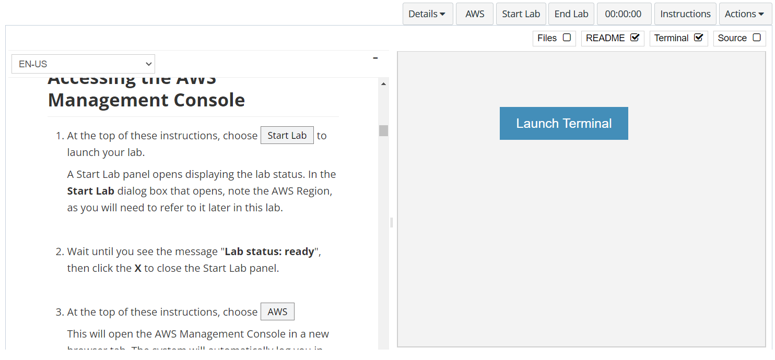
In aws labs click on start lab

Slide 4
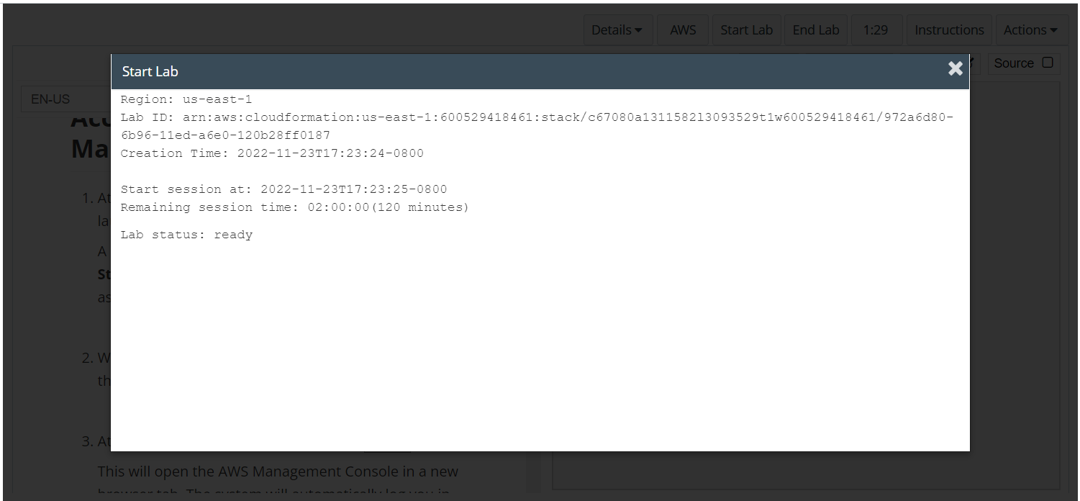
Wait to see lab ready status in the window then press x and click on aws to launch console

Slide 5
Task 1: Configuring an IAM group with policies and an IAM user

Slide 6
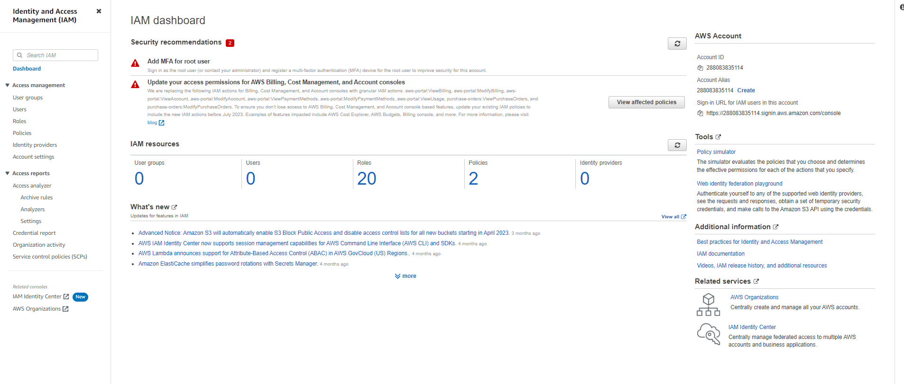
Open the iam services page
In the console, open the IAM service page

Slide 7
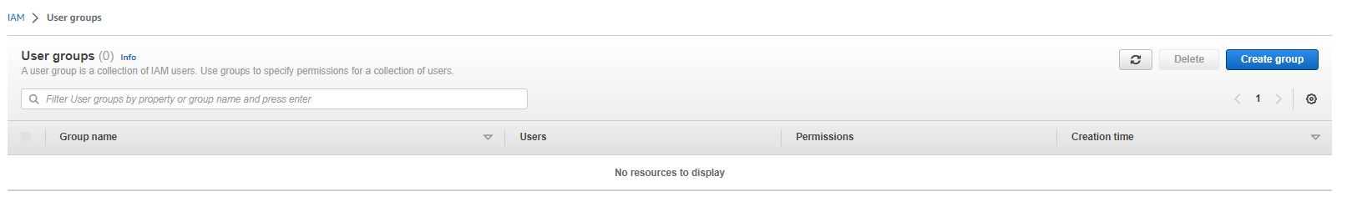
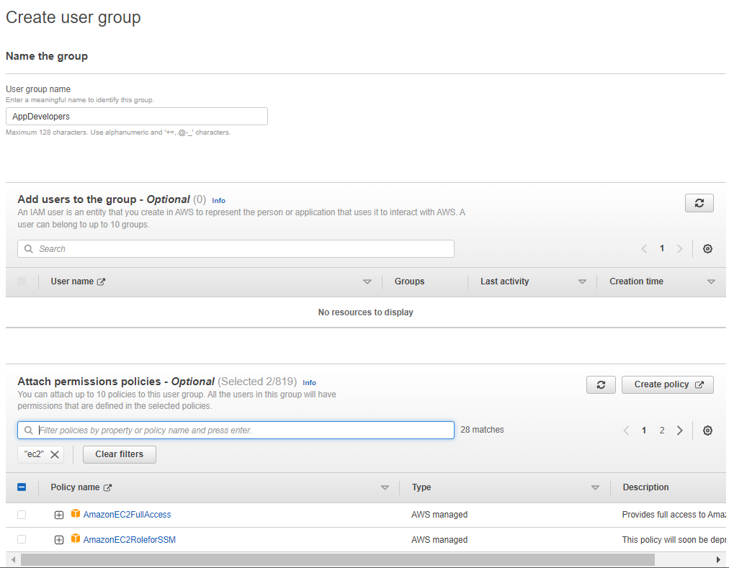
Click on create group and add the name and the associated permissions
Create an IAM group named AppDevelopers and attach the policies:
AmazonEC2ReadOnlyAccess
AWSCloud9EnvironmentMember
Then click create Group

Slide 8
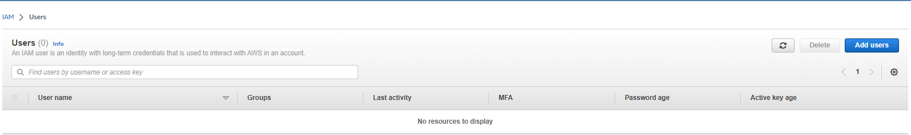
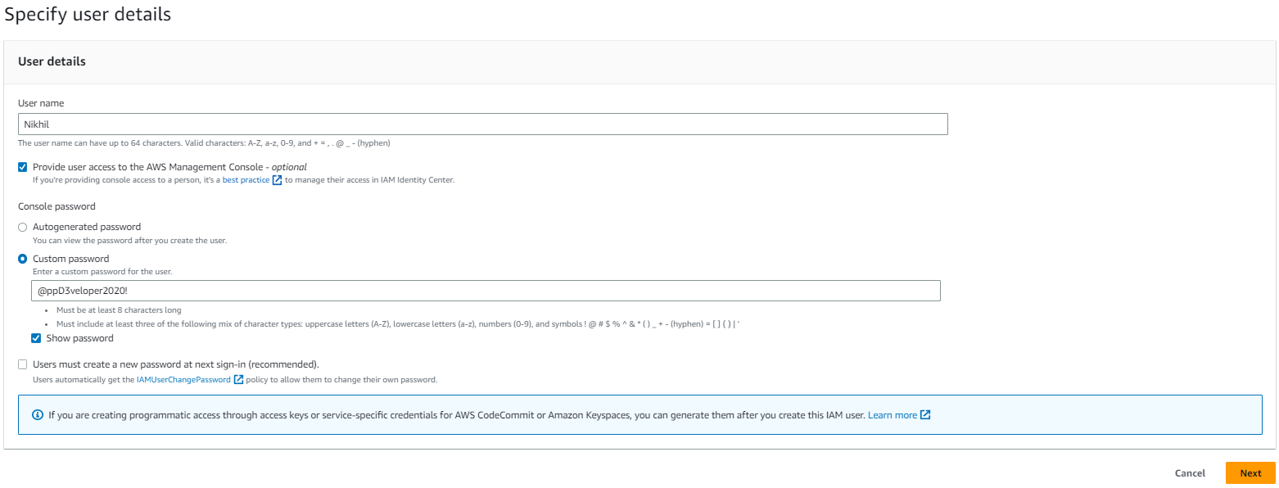
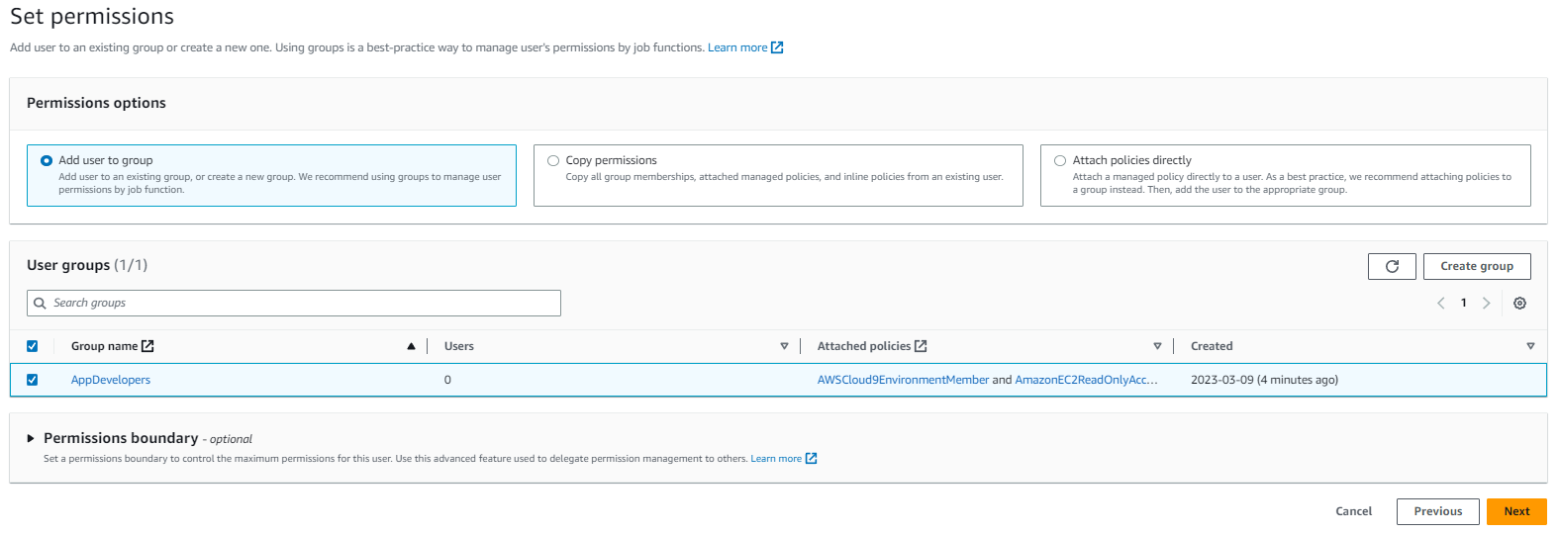
Go to users tab and click on create user button and add Nikhil as details below
Create an IAM user and add the user to the AppDevelopers group.
User name: Nikhil
Access type: AWS Management Console access
Custom password: @ppD3veloper2020!
Require password reset: Clear this check box
Add Nikhil to the AppDevelopers group
Note: You don't need to add any tags In the Success screen, you can optionally choose Download .csv and save the file to your computer
Choose Close
Then click create Group

Slide 9
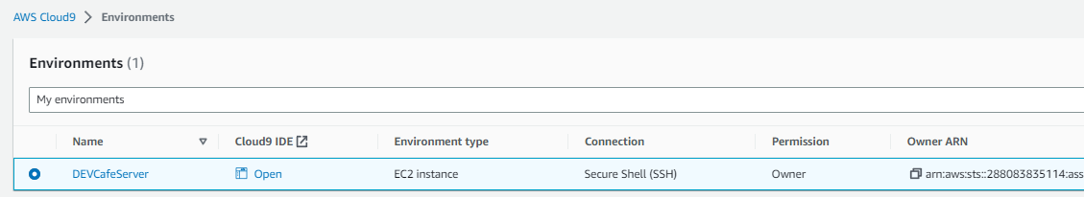
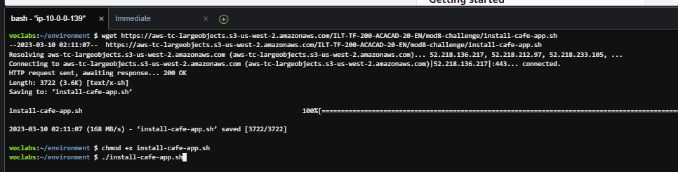
In the aws go to aws cloud9 and open ide for dev café server
While still logged in as the voclabs user (Sofía), connect to the AWS Cloud9 IDE and set up the café web application
Open the AWS Cloud9 service page and under DEVCafeServer, choose Open IDE
The AWS Cloud9 IDE that run on an EC2 instance should now display
In the Bash terminal window at the bottom of the screen, paste and run these three commands:
wget https://aws-tc-largeobjects.s3-us-west-2.amazonaws.com/ILT-TF-200-ACACAD-20-EN/mod8-challenge/install-cafe-app.sh
chmod +x install-cafe-app.sh
./install-cafe-app.sh
Note: You do not need to wait for the script to finish running. Instead, go to the next step.

Slide 10
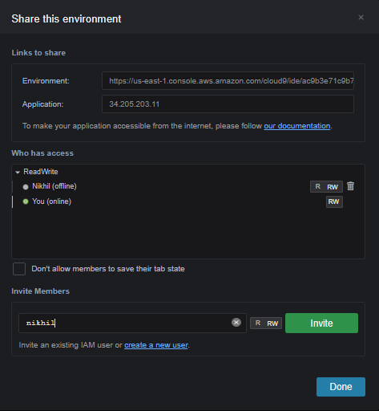
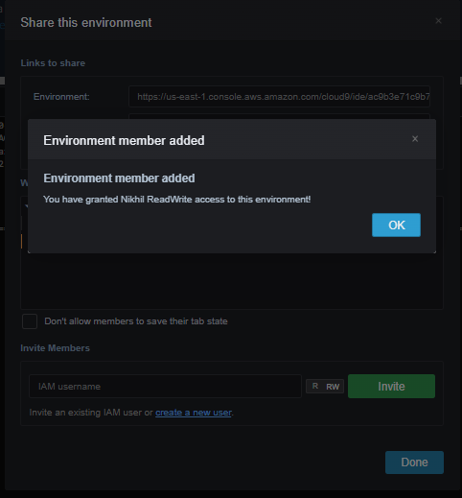
Share the aws cloud9 environment with Nikhil and close the cloud9 ide but not the aws console page
Share the AWS Cloud9 environment with the Nikhil user.
In the top-right corner of the AWS Cloud9 IDE, choose Share.
In the Share this environment panel, under Invite Members, enter Nikhil and choose Invite.
Choose OK, choose OK again, and then choose Done.
Important: Close the AWS Cloud9 IDE browser tab, but leave open at least one other browser tab where you are logged into the AWS Management Console as the voclabs user (Sofía)

Slide 11
Task 2: Logging in as Nikhil and testing access

Slide 12
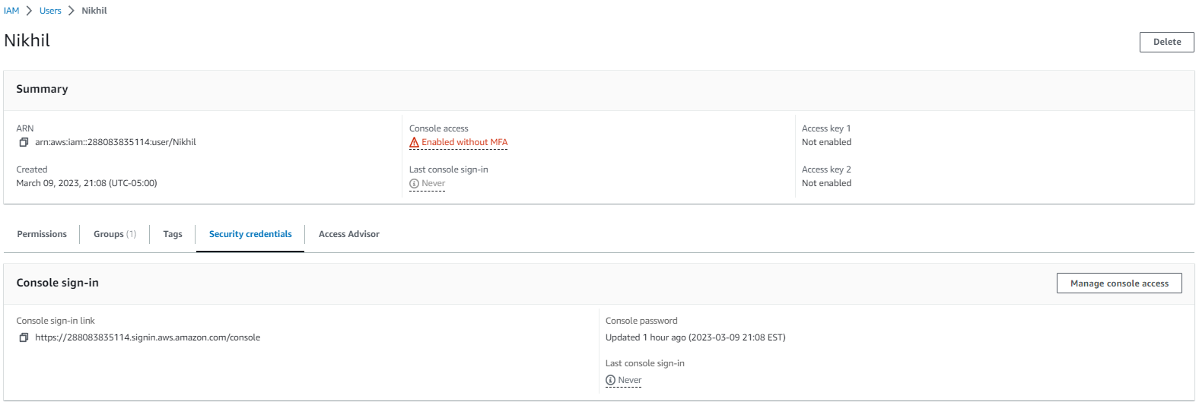
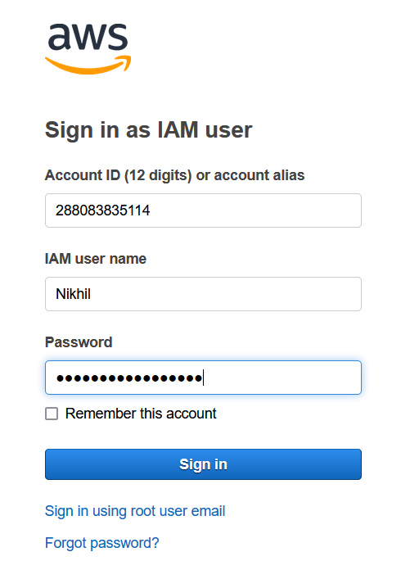
To login as Nikhil follow the steps below
As Nikhil, log in to the AWS Management Console.
In the browser tab where you are logged in as the voclabs user (Sofía), open the IAM console, choose Users, and then choose Nikhil.
Choose the Security credentials tab, and in the Sign-in credentials section, copy the Console sign-in link.
Paste the link into an incognito or private browser tab (or other browser as explained in the previous tip).
In the Sign in as IAM user screen, enter Nikhil's credentials and choose Sign in.
IAM USER NAME – Nikhil
Password: @ppD3veloper2020!

Slide 13
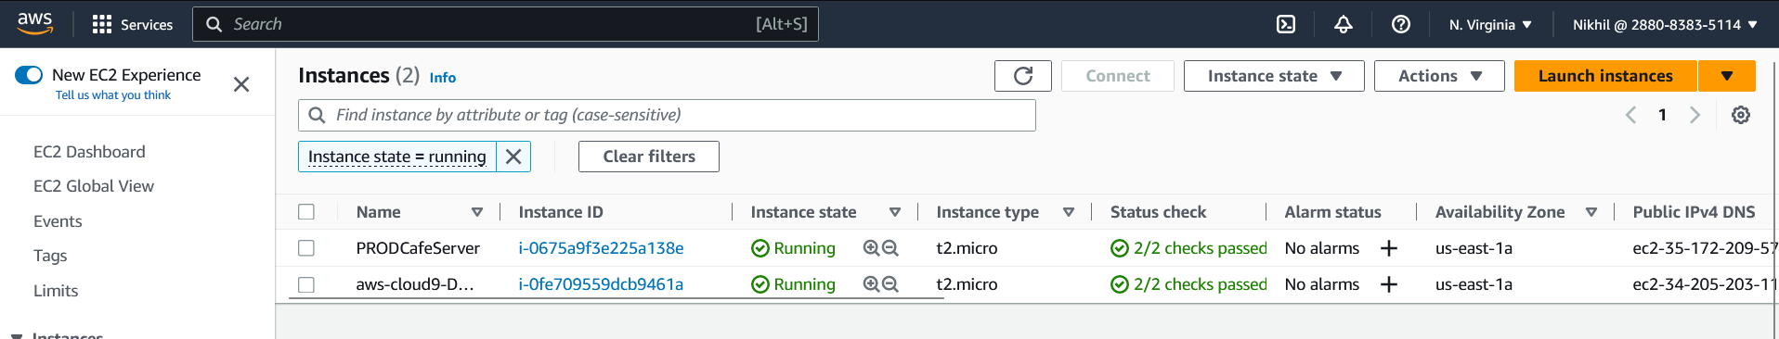
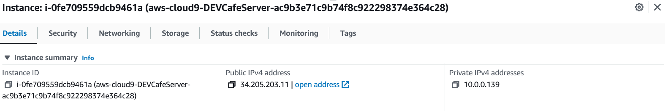
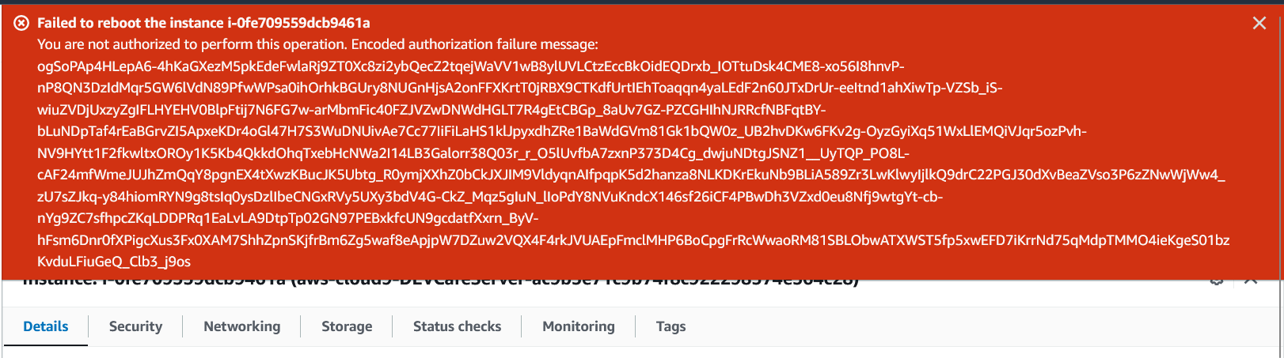
OPEN THE EC2 CONSOLE AND SWITCH TO N.VIRGINIA AND COPY THE ADDRESS OF DEV CLOUD9 INSTANCE
Open the Amazon EC2 console and in a browser tab, load the café web application.
Verify that you are in the correct Region (for example, N. Virginia) and switch to it, if necessary.
You should be able to view all the details of the EC2 instances.
Locate and copy the IPv4 Public IP address of the aws-cloud9-DEVCafeServer instance.
In a new browser tab, load http://<dev-public-ip-address>/cafe, where <dev-public-ip-address> is the IP address that you copied.
The café website should display. Keep this browser tab open for later in the lab
12. Test your Amazon EC2 access further by attempting to restart the web server.
Try to reboot the aws-cloud9-DEVCafeServer instance
Tip: To find the Reboot option, select the instance and look in the Instance state menu.

Slide 14
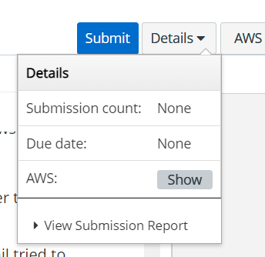
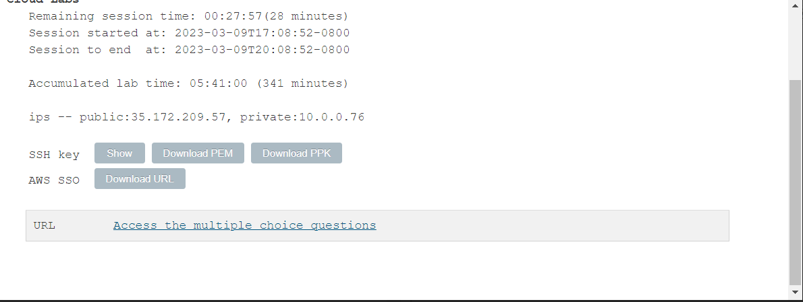
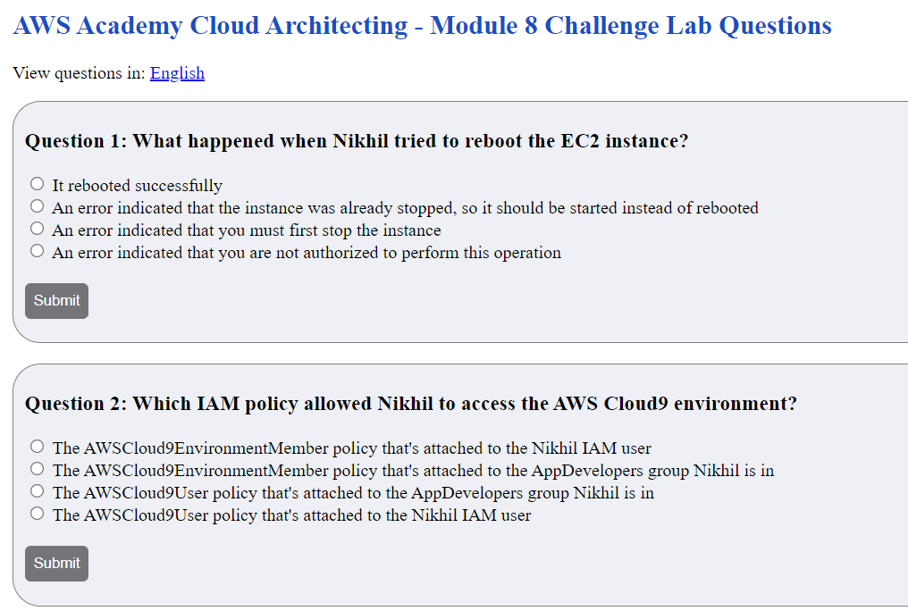
Answer the questions related to lab, answer question 1 and 2

Slide 15
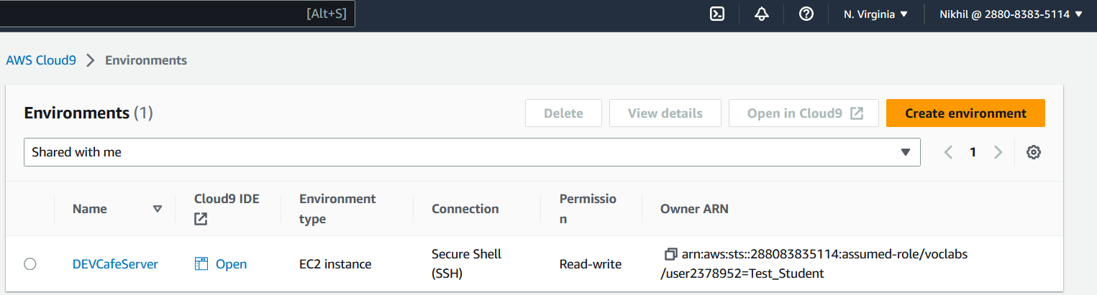
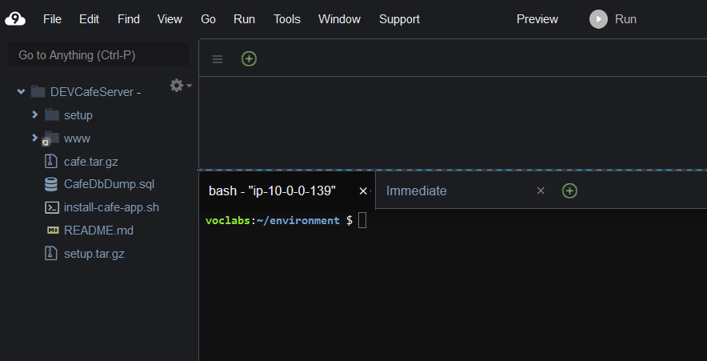
Open the ide in n.virginia in shared with me environment
Browse to the AWS Cloud9 console, and connect to the AWS Cloud9 IDE on the DEVCafeServer EC2 instance.
From the Services menu, choose AWS Cloud9.
On the left, expand the menu by choosing the (menu icon), choose Shared with you, and verify that the DEVCafeServer environment is available.
Choose Open IDE.
Note: You have just connected to the guest OS of the aws-cloud9-DEVCafeServer EC2 instance. You observed this instance in the Amazon EC2 console a moment ago. You can use the IDE to browse and edit files on the web server. It also provides a Bash terminal that runs on the instance.

Slide 16
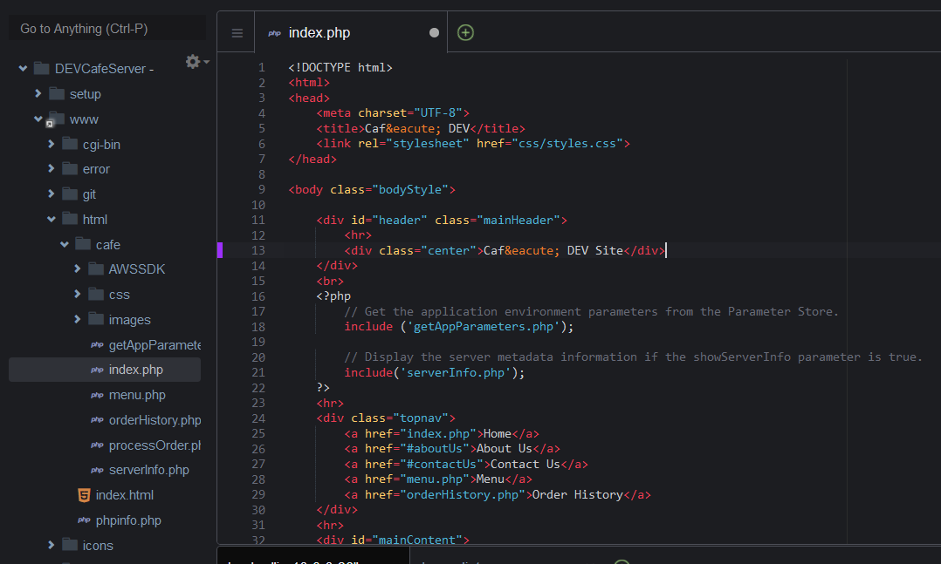
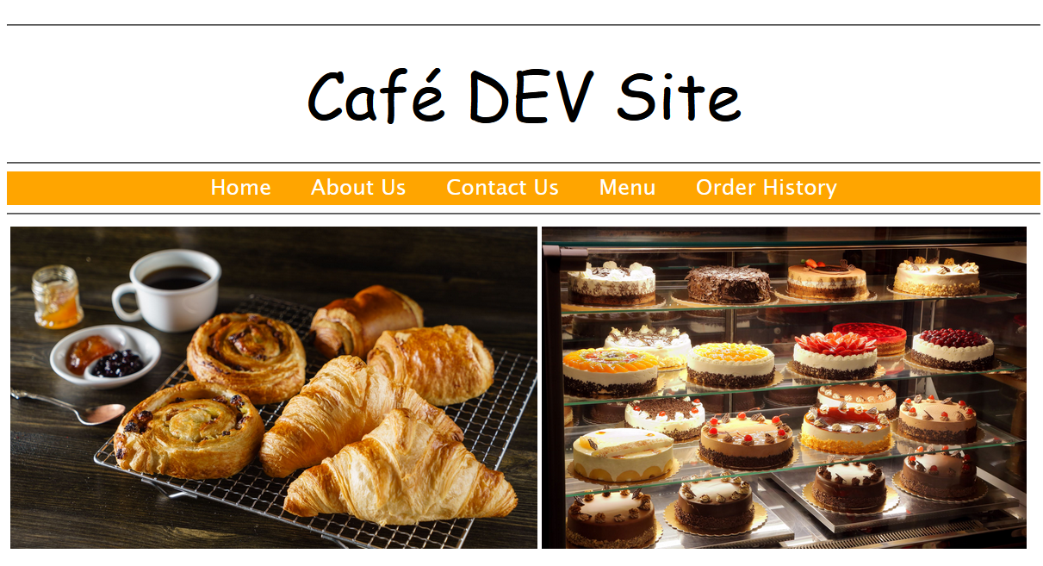
Open the index.php file from the directory
On the development instance of the café website, modify the main heading for the webpage.
Open the main webpage in the editor by going to the file browser, navigating to the DEVCafeServer/www/html/cafe directory, and double-clicking index.php.
Modify line 13 So that it reads:
<div class="center">Caf&eacute; DEV Site</div>
To save the change, choose File > Save and in the browser, refresh the http://dev-public-ip-address/cafe/ webpage.
Notice that, while acting as Nikhil, you changed the main heading of the webpage in the development environment.

Slide 17
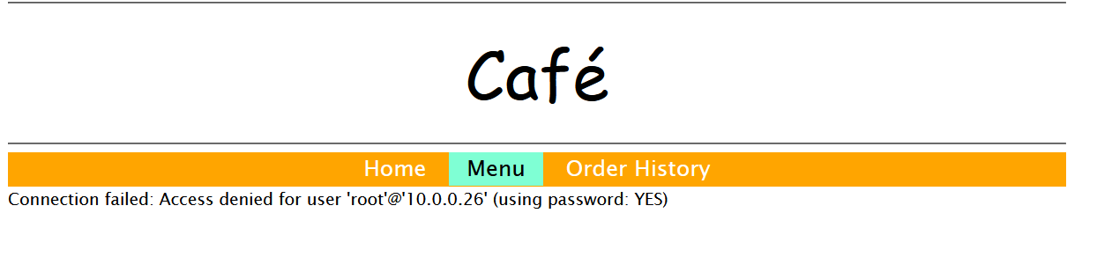
Test the connectivity of the web application database
Test the connectivity of the web application database.
In the café website, choose Menu.
What message displays?
Return to the browser tab with the multiple-choice questions for this lab, and answer the following question.
Question 3: Which message was displayed on the Menu page of the café website's development instance?
Nikhil recalls that the database connection parameters are stored in the AWS Systems Manager Parameter Store.

Slide 18
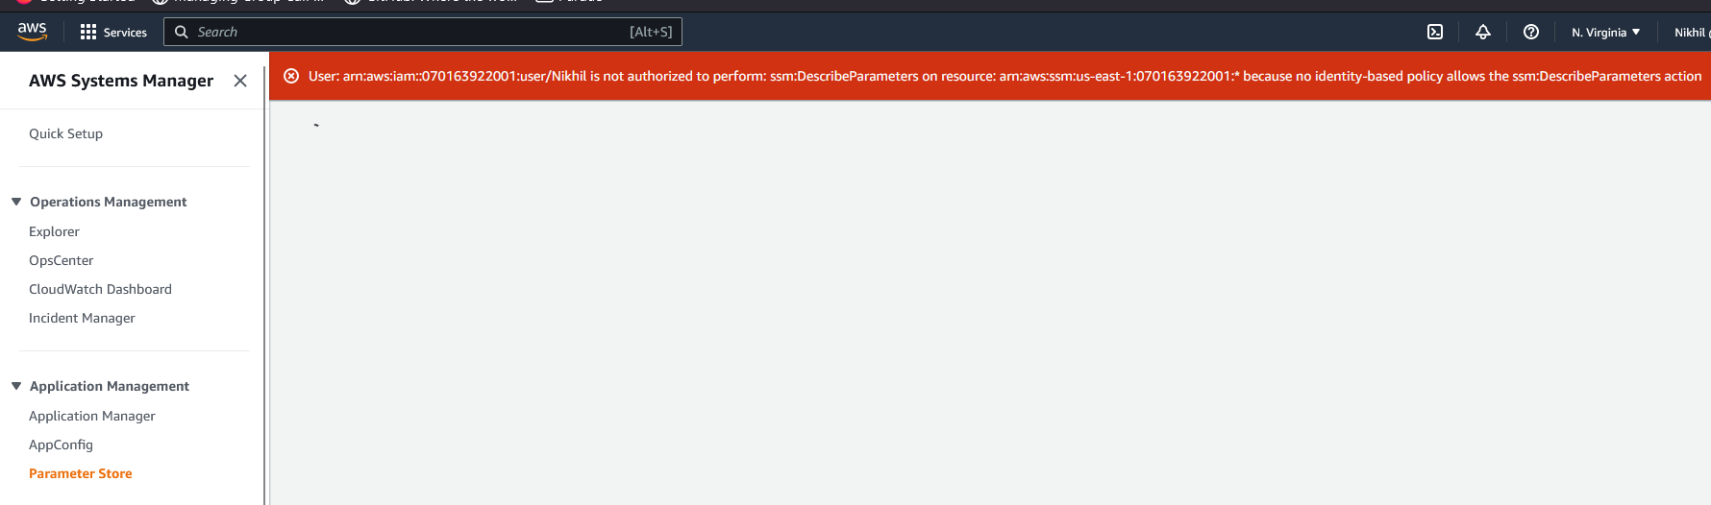
Open the systems manager parameter store
As Nikhil, open the Systems Manager Parameter Store.
In the console, open the Systems Manager service.
From the menu on the left, choose Application Management > Parameter Store.
What message displays?
Return to the browser tab with the multiple-choice questions for this lab, and answer the following question.
Question 4: Which message was displayed when Nikhil opened the Systems Manager Parameter Store page in the console?
Nikhil alerts Sofía about the issue on the development server that's preventing him from improving the café web application. Sofía is concerned. She asks Nikhil to check if the production version of the website is experiencing the same issue.

Slide 19
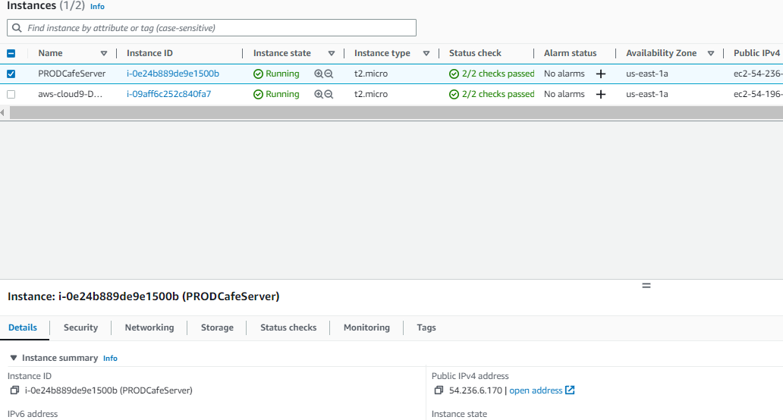
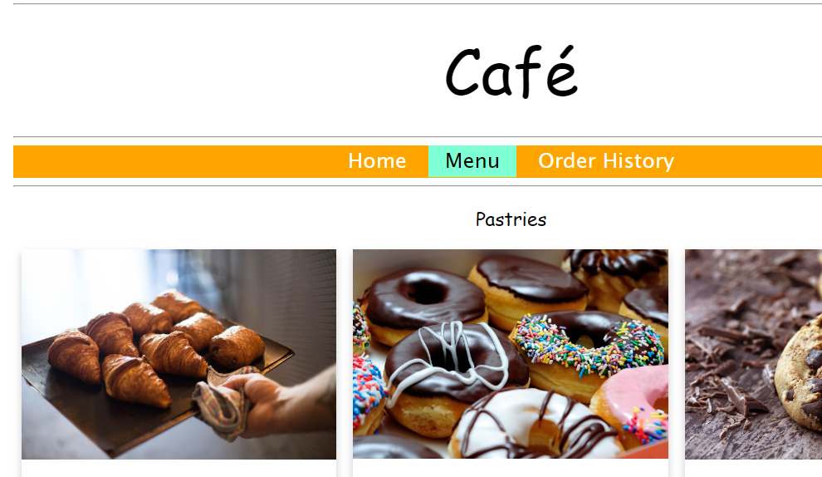
Check production environment
As Nikhil, verify that the production café web application is working correctly.
Open the Amazon EC2 console and copy the IPv4 Public IP address of the PRODCafeServer instance.
In a new browser window, load http://prod-public-ip-address/cafe/menu.php
Does the webpage display correctly, and can you place orders?

Slide 20
Task 3: Configuring IAM for database administrator user access

Slide 21
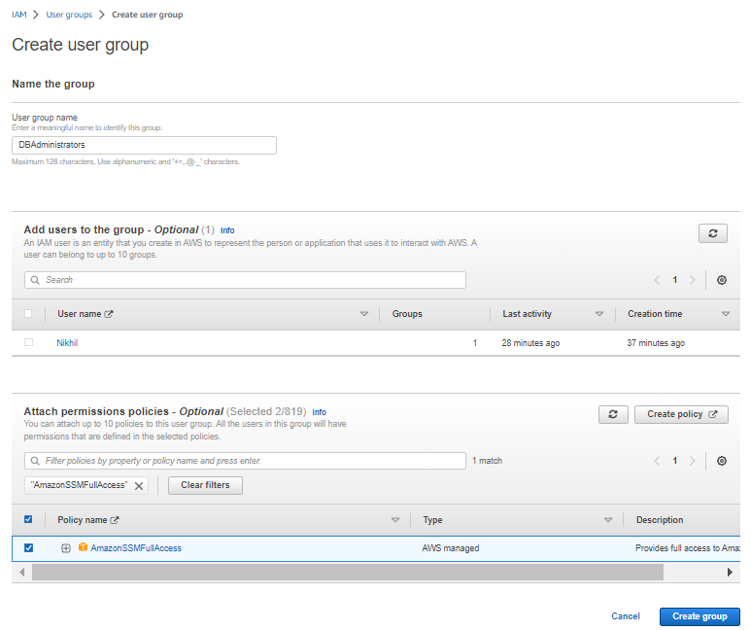
Create iam group called dbadministrators using sofia’s account
Back in the browser where you are logged in as the voclabs user (Sofía), create an IAM group named DBAdministrators, with the following permissions:
AmazonRDSReadOnlyAccess
AmazonSSMFullAccess
Note: In a real-world situation, Sofia would need to grant more than simply read only access to RDS to her database administrators. However, the permissions in this lab environment, do not allow you to attach the AmazonRDSFullAccess policy. Instead, for this lab, you should use the AmazonRDSReadOnlyAccess policy as a substitute.

Slide 22
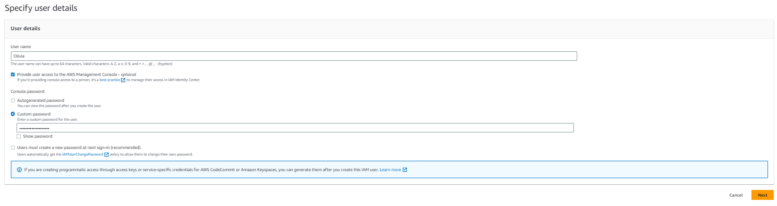
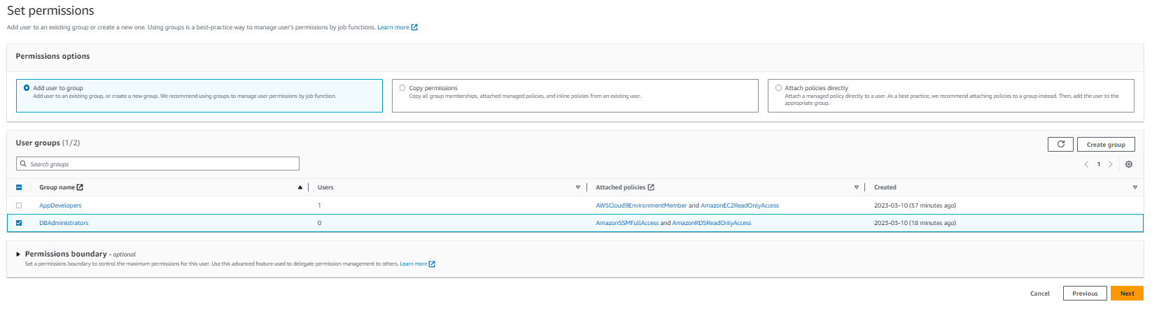
Create a user olivia and add her to the new group
Create an IAM user that's named Olivia with access to the AWS Management Console.
Set a custom password: Db@dministrat0r2020!
Clear the requirement to reset the password
Add Olivia to the DBAdministrators group

Slide 23
Task 4: Logging in as the database administrator and resolving the database connectivity issue

Slide 24
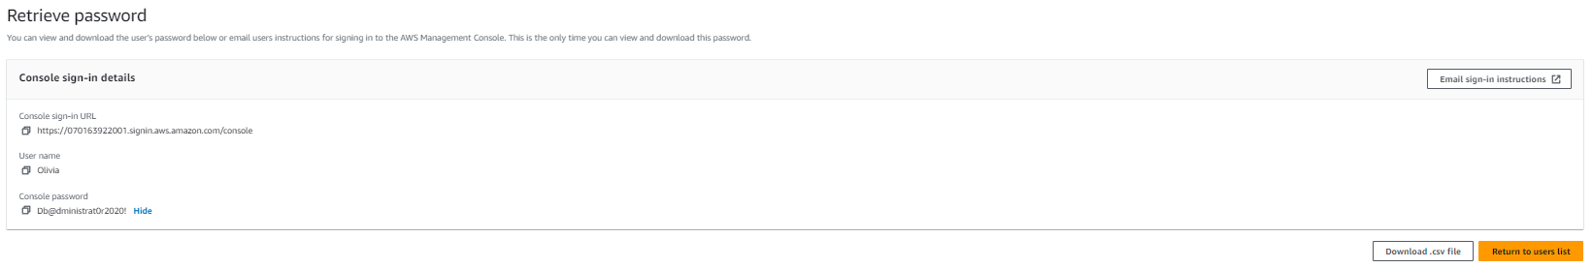
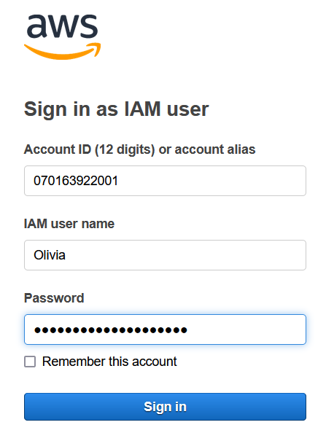
Log in as olivia after logging out from nikhil
As Olivia, log in to the AWS Management Console.
Tip: Use the incognito session, private session, or other browser type that you used to log in as Nikhil. To do this:
Choose Nikhil @ <account-number> in the top-right area of the console and choose Sign Out.
Then, choose Log back in.
The Sign in as IAM user screen should display, with the Account ID pre-populated.
Note: If the login screen doesn't display the account ID, return to the browser tab where you are still logged in as the voclabs (Sofía) user. In the IAM console, choose Users and choose Olivia. Choose the Security credentials tab. In the Sign-in credentials section, copy the Console sign-in link.
Sign in with Olivia's credentials:
IAM user name: Olivia
Password: Db@dministrat0r2020!

Slide 25
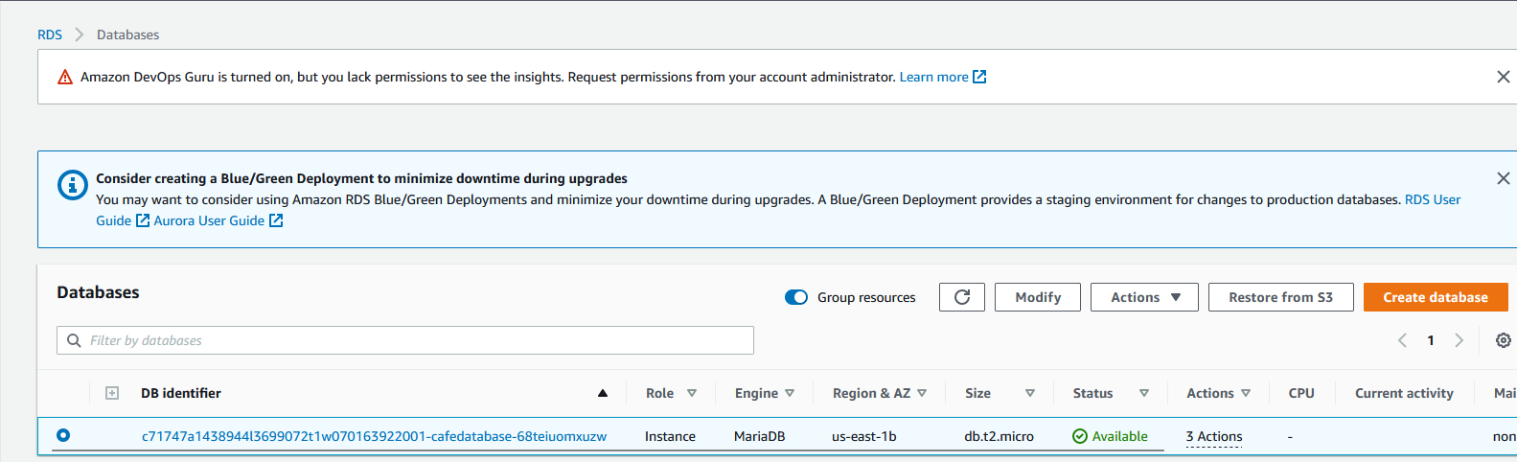
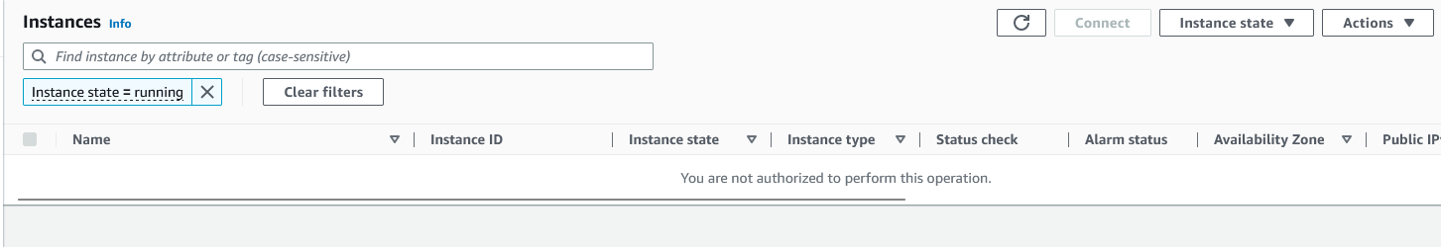
Verify the rds database is running
Verify that the RDS database is running.
Open the Amazon RDS service page and choose Databases.
Verify that the Status of the database instance is Available.
Olivia observes that the database is running.
She recalls that the development environment connects to the database by using parameters that are stored in the Systems Manager Parameter Store. Olivia wonders if the DEVCafeServer EC2 instance has permissions to read the parameters out of the Parameter Store.
Open the Amazon EC2 console and choose Instances (running).

Slide 26
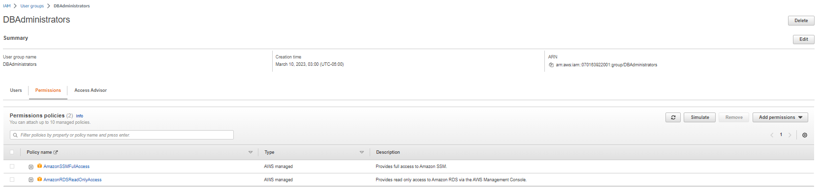
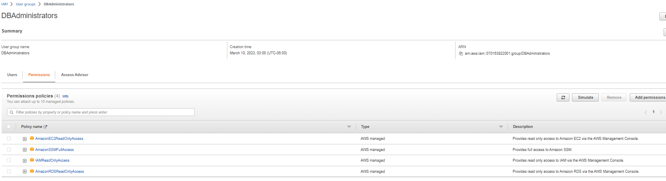
RETURN TO AWS CONSOLE LOGGED IN AS SOFIA AND UNDER IAM USERGROUPS ADD THE FOLLOWING
Open the DBAdministrators group, and attach these policies:
AmazonEC2ReadOnlyAccess
IAMReadOnlyAccess
Note: Sofía realizes that Olivia needs some IAM permissions if she must access the details of the IAM role that's attached to the EC2 instance.

Slide 27
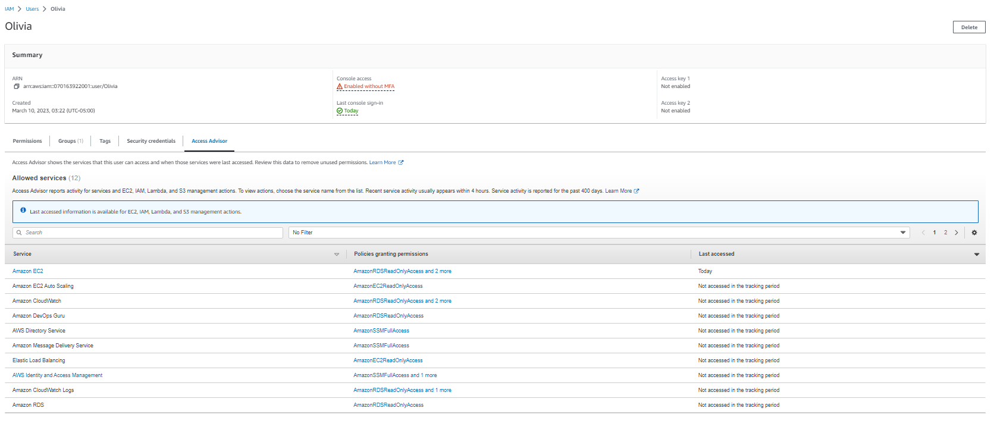
RETURN TO AWS CONSOLE LOGGED IN AS SOFIA AND UNDER IAM USERGROUPS ADD THE FOLLOWING
Still as the voclabs user (Sofía), check which services and features Olivia used.
In the IAM console, open the Olivia user, and choose the Access Advisor tab
Notice that you can see which service areas that Olivia visited. Recent service activity usually appears within 4 hours (as stated in the Access Advisor details). You might not see any Last accessed data for Olivia yet.
You can use this view to gain insight into how a user's permissions might be more open than they should be. This information enables you to more closely align access rights with the principle of least privilege.
Sofía asks Olivia to check her Amazon EC2 access.

Slide 28
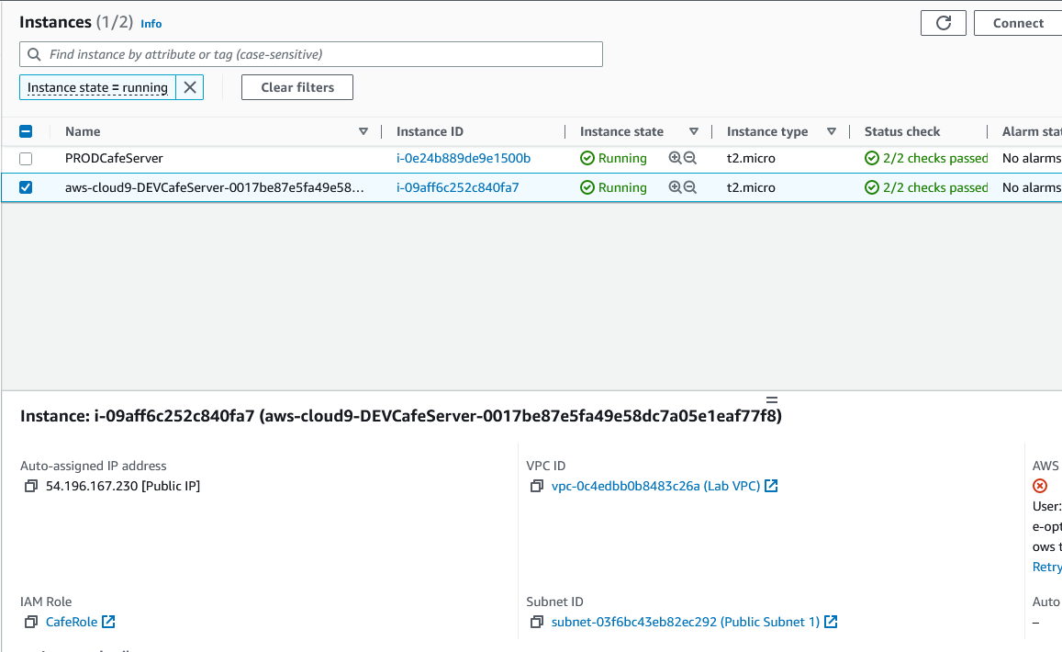
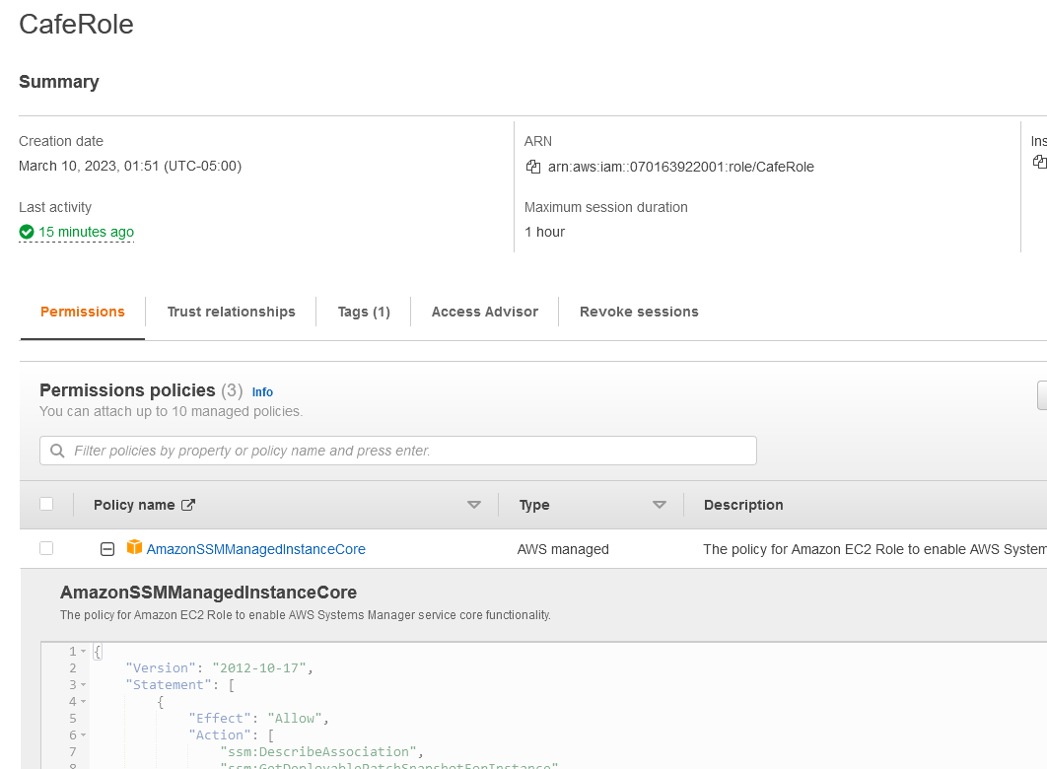
RETURN AS OLIVIA TO THE EC2 CONSOLE
As Olivia, return to the browser tab where the Olivia user is logged in and refresh the instances page of the Amazon EC2 console.
Olivia should now be able to access both running EC2 instances.
Select the aws-cloud9-DEVCafeServer instance.
In the Details tab, find IAM role and choose CafeRole.
In the Permissions tab, expand the AmazonSSMManagedInstanceCore policy to see the permission details in JSON.
Review the policy permissions.
Answer Question number 6

Slide 29
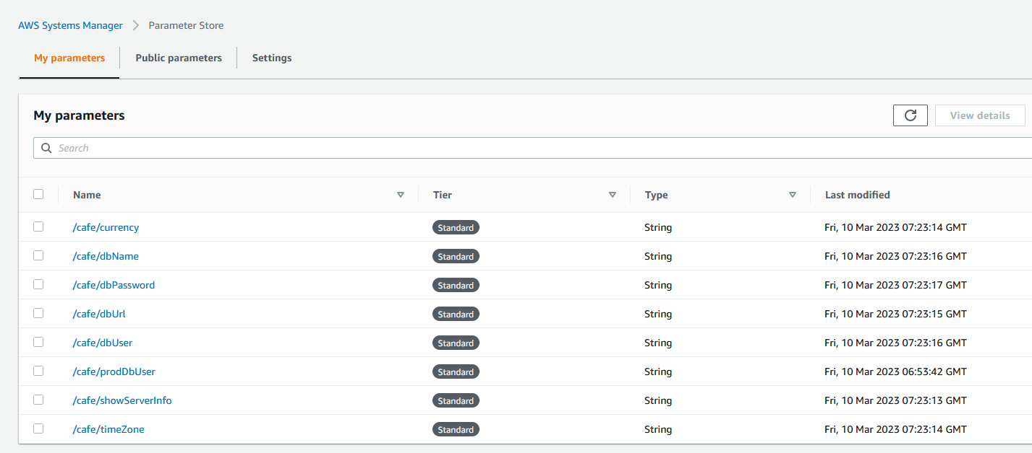
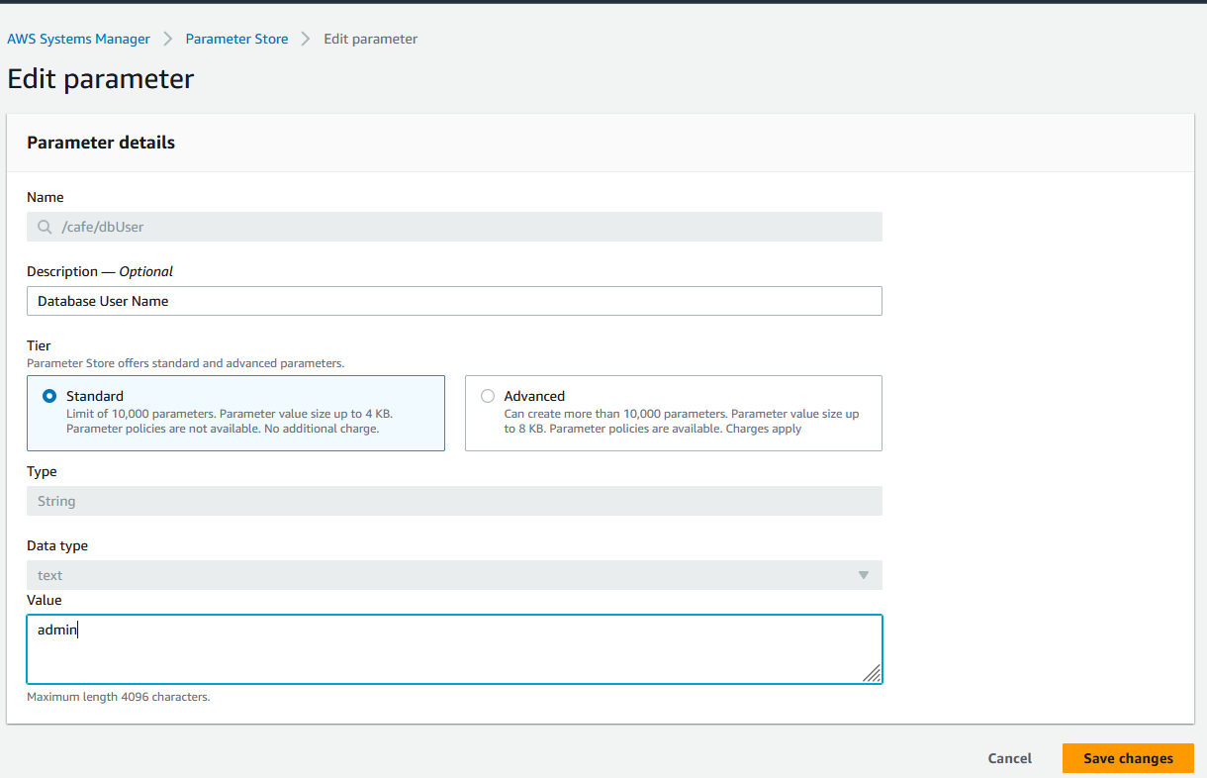
RETURN AS OLIVIA TO THE EC2 CONSOLE
As Olivia, update the dbUser value in the Systems Manager Parameter Store
Note – the value for the parameter store is the username of the RDS database

Slide 30
RETURN AS OLIVIA TO THE EC2 CONSOLE
As Olivia, update the dbUser value in the Systems Manager Parameter Store
Note – the value for the parameter store is the username of the RDS database

Slide 31
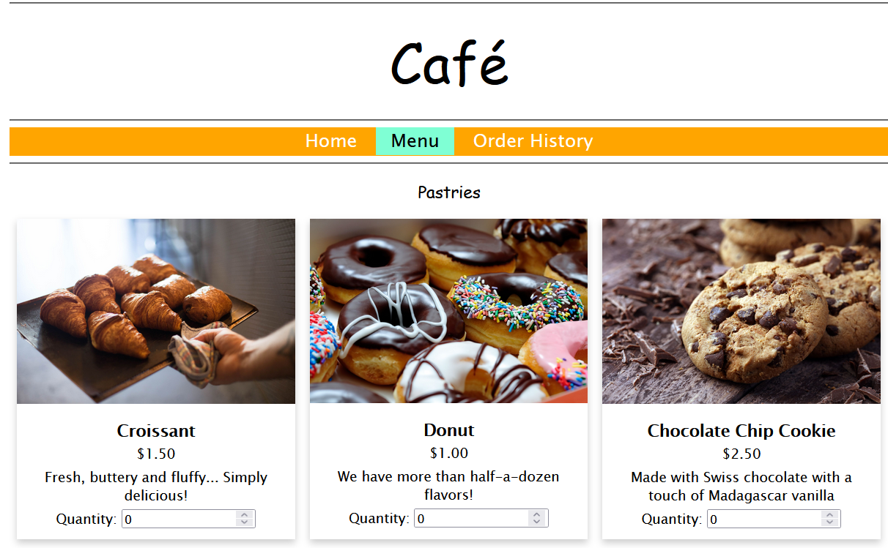
Reload the website with the dev ip address and try to order
In the web application on the development café server, refresh the Menu page.
If this webpage isn't already open, load http://<dev-public-ip-address>/cafe/menu.php in a browser (where <dev-public-ip-address> is the actual IPv4 public IP address of the aws-cloud9-DEVCafeServer instance).
Does the full page of content display correctly now? Can you successfully submit an order?
Congratulations! You acted as a member of the DBAdministrators group, and you fixed the website. Nikhil thanks Olivia for resolving the issue, and Olivia also informs Sofía that the issue is resolved.

Slide 32
Task 5: Using the IAM Policy Simulator and creating a custom IAM policy with the visual editor

Slide 33
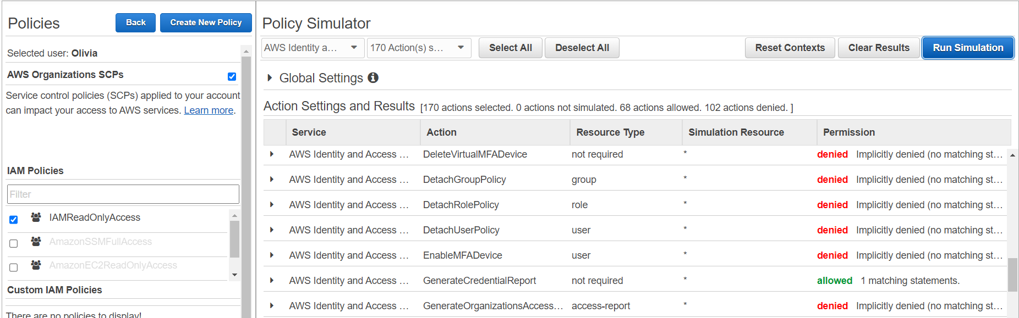
Return to the iam console where you are logged with sofia and paste the url below to simulate policies
Choose the Olivia user
In the IAM Policies list, make sure that the IAMReadOnlyAccess policy is selected. However, clear the check boxes of the other policies.
In the Policy Simulator section, choose Select service. In the Filter search box, enter Ident and select Identity and Access Management
Choose the Select All option (to the right of the Select actions menu), and then choose Run Simulation.
In the Action Settings and Results panel, a list of actions should display.
The Permission column displays Olivia's permissions for each action. The IAMReadOnlyAccess policy denies Olivia the permissions to perform Add or Create actions. However, scroll to find the actions that she can take.
The summary (at the top of the list) shows that Olivia is currently allowed to take 57 IAM actions.

Slide 34
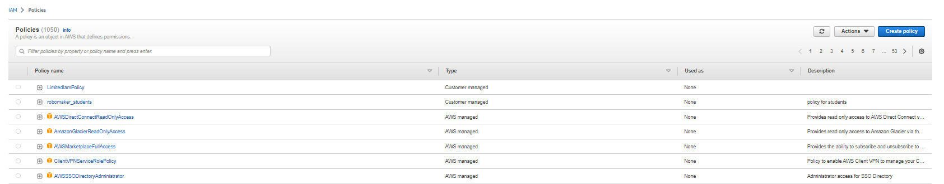
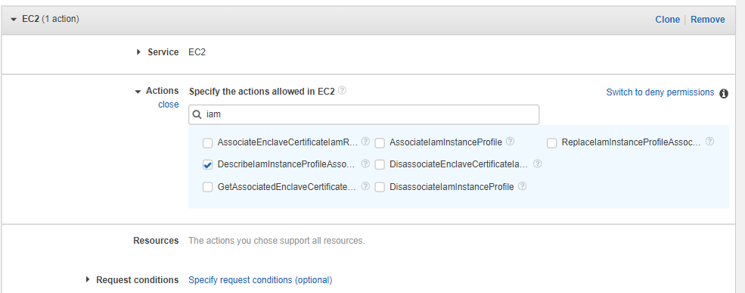
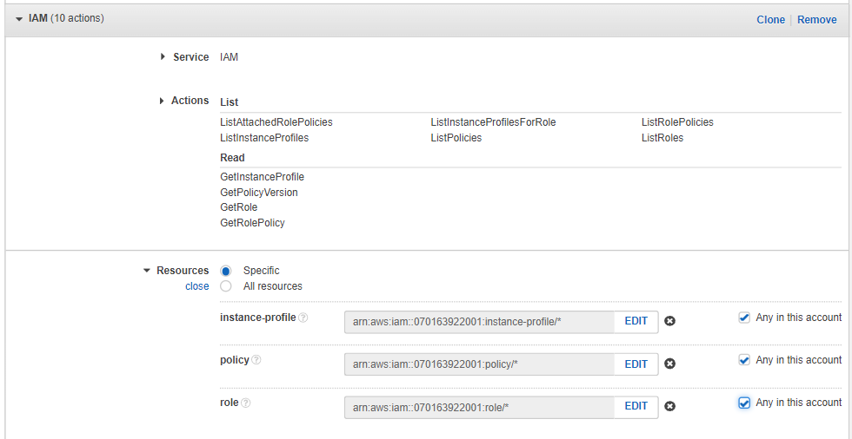
Return to iam console logged in as sofia
In the Visual editor tab, configure the following settings.
Select Choose a service. Search for and choose EC2.
In the Actions search box, search for IAM and select DescribeIamInstanceProfileAssociations.
At the bottom of the screen, choose Add additional permissions.
Select Choose a service. Search for and choose IAM.
In the Actions search box, search for Get and select the following actions –
GetPolicyVersion
GetRole
GetRolePolicy
GetInstanceProfile
Back in the search box, search for List and select the following actions –
ListAttachedRolePolicies
ListInstanceProfiles
ListInstanceProfilesForRole
ListPolicies
ListRolePolicies
ListRoles
Expand the Resources section and for all three resource types (instance-profile, policy, and role) select Any in this account.

Slide 35
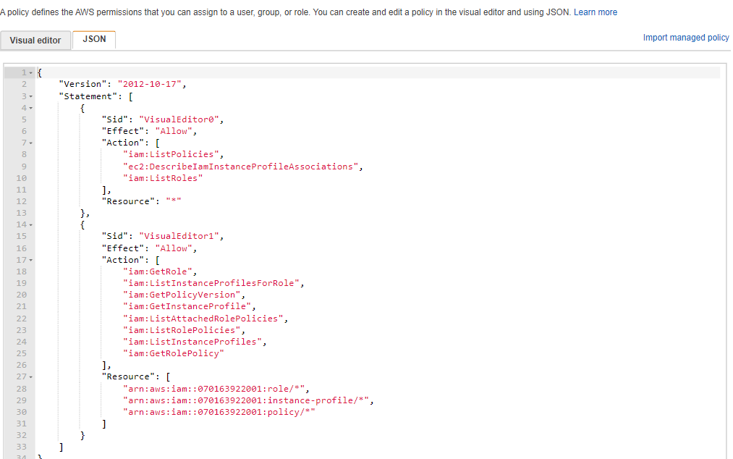
View the permissions in json
Back at the top of the screen, choose the JSON tab
This view shows the JSON document that you just composed by using the visual editor.
Verify that the policy document details match what is shown in the following example in aws labs
Unfortunately, in this lab environment, we can't grant you the permissions to create an IAM policy. You will get a permissions error if you choose Review policy, give the policy a name, and then choose Create policy
Exit the Create policy wizard by choosing Cancel.

Slide 36
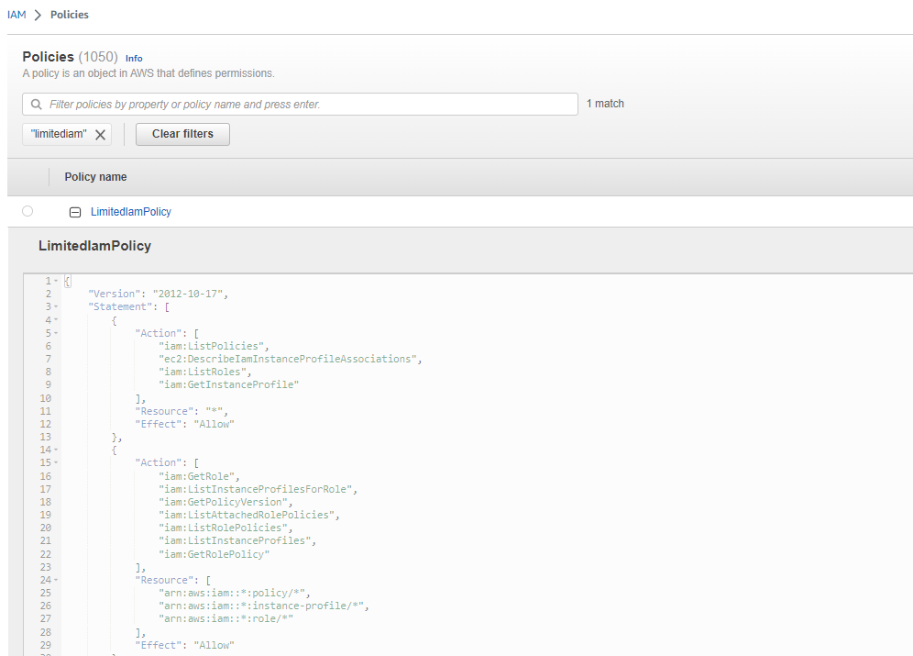
In the policies visualize the limitediampolicy
In the Policies search box, search for LimitedIamPolicy.
Observe that the policy details match the one you worked to build, as shown in the previous screen capture.
Note: The Sid elements in a policy are optional. Also, the order in which Effect, Action, and Resource appear in a policy document doesn't affect how the policy works.c

Slide 37
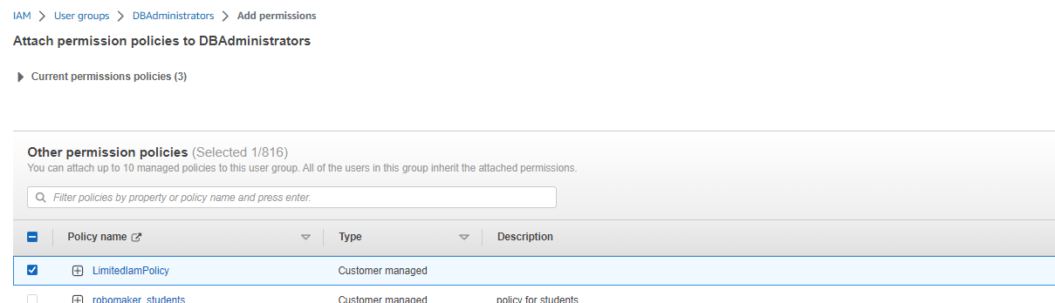

In dbadministrator group remove IAMReadOnlyAccess and attach LimitedIamPolicy
Edit the DBAdministrators IAM group.
Attach the LimitedIamPolicy policy
Remove the IAMReadOnlyAccess policy
Sofía asks Olivia to confirm that she can still access the details of the CafeRole IAM role, even with the more limited IAM access rights now granted to her.

Slide 38


Return to olivia’s browser and validate that you still have the access
Return to the browser tab where you are logged in as Olivia, and verify that you can still access the details of CafeRole.
In the Amazon EC2 console, select the aws-cloud9-DEVCafeServer instance.
In the Details tab, notice that you can now see that the IAM role attached is named CafeRole.
Still as Olivia, go to the IAM console and choose Roles.
Search for and select the CafeRole.
In the Permissions tab, expand the AmazonSSMManagedInstanceCore policy and verify that you can still see the JSON document details.

Slide 39
THANK YOU
Amrit Singh

